Slide 1
WGST 100-991: Introduction to Women’s and Gender Studies
Week 3: Wednesday, Sept 19/18
Construction of Sex and Gender: Feminism

Slide 2
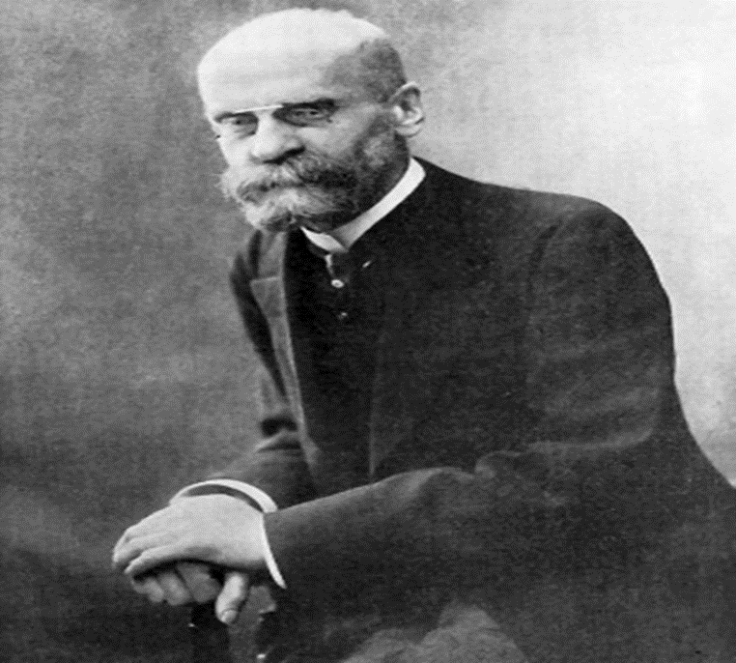
Recap: Structural Functionalism

Slide 3
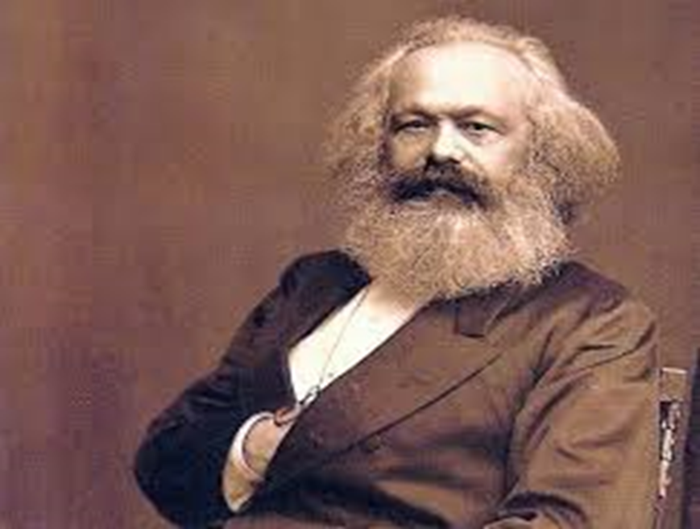
Recap: Critical Theory

Slide 4

Recap: Symbolic Interactionism

Slide 5

Feminist Theory

Slide 6
Feminist Theory
Subset of Critical Theory
Patriarchy: the hierarchical organization of society, with males dominating most of the positions of power and wealth, while a disproportionate number of females fill subordinate positions with little wealth or control.

Slide 7
Feminist Theory: The Media Example
Documentary
Netflix: Miss Representation

Slide 8
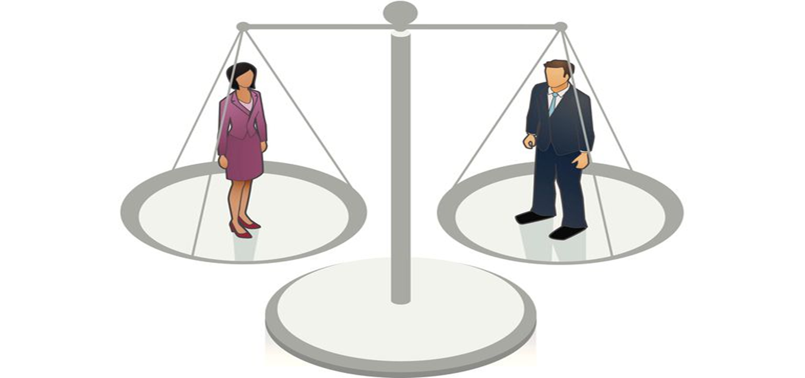
Strands of Feminism: Liberal Feminism

Slide 9
Strands of Feminism: Liberal Feminism
Key focus: equality of opportunity
Liberalism: the human being is an autonomous self who is able to make free choices in a “free and democratic” society.
Women have been largely excluded from positions of power in the workplace and social institutions.
Goal to improve equity in pay, equalize access, legal parity, and choice in opportunities.

Slide 10
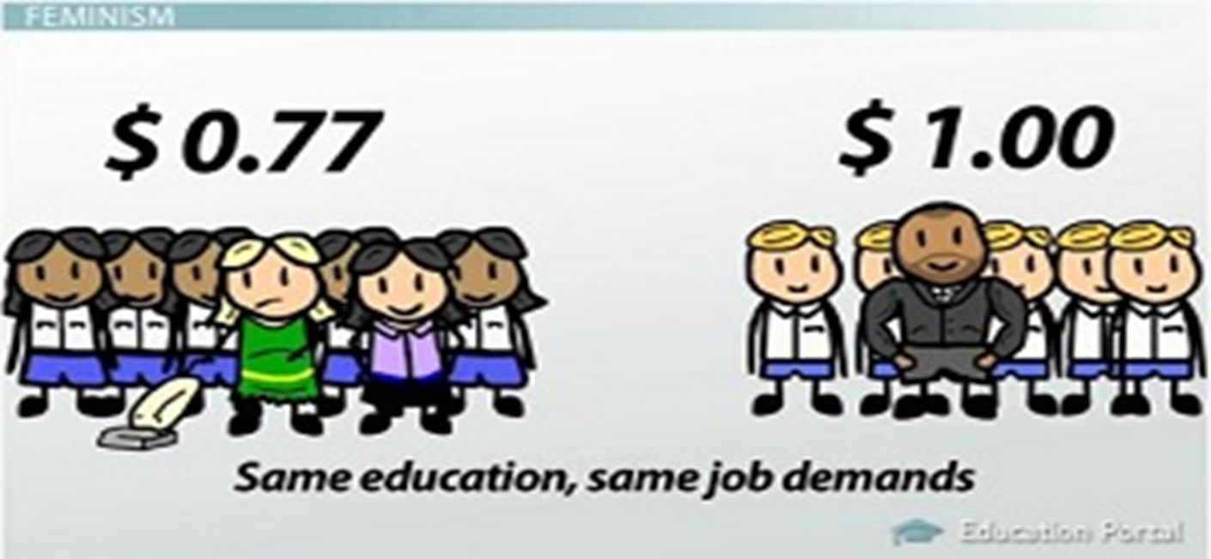
Strands of Feminism: Socialist Feminism

Slide 11
Strands of Feminism: Socialist Feminism
Key Focus: economic systems
Oppression in the form of both patriarchy and class.
Capitalism exploits classes and women are double exploited.
Women are marginalized not only in the paid workforce but in the unpaid workforce as well.

Slide 12

Strands of Feminism: Radical Feminism

Slide 13
Strands of Feminism: Radical Feminism
Key Focus: power and oppression
Rather than try to work within the structures/institutions of the social system (like Liberal Feminism), the goal is to completely end them and create new ones constructed on socially reconstructing the concepts of sex and gender.
Goals include complete reproductive control, sexual freedom, and reshaping the socialization process to push the idea that women share the same qualities of men.

Slide 14

Strands of Feminism: Cultural Feminism

Slide 15
Strands of Feminism: Cultural Feminism
Key Focus: celebrating difference
Argue that women have unique and valuable differences that should be recognized.
Women speak and feel differently which should be acknowledged as equally valid.
Unique virtues include connection, nurturance, and compassion that can be celebrated in women-created environments.

Slide 16
Backlash to Feminism
For some, the very term Feminism evokes a backlash.
This has been formally expressed in two ways:
1. equality has essentially been achieved
According to this argument western society is already as equal as it can be and, thus, pushing for more women’s rights only serves to disadvantage men in social institutions.
Example: women already hold powerful positions in society, women already outnumber men in achieving advanced degrees, and many social institutions have hiring practices that actively seek out women to hire for certain positions.

Slide 17
Backlash to Feminism
Counterargument:
Women still only earn approx. 70-80% of what men earn in comparable jobs
A higher proportion of women in Canada are poorer than men.
17.1% of women and 14.7% of men living in families are poor, 42% of women and 34% of men living alone

Slide 18
Backlash to Feminism
2. We should all make it on our own merits
“leveling the playing field for women suggest they need to be accommodated as a “special needs group” when they should be judged on their individual efforts and credentials.
Example: the economy in general runs on a lassaiz-faire philosophy that suggests anyone can be successful and dependent on individual effort.
Canada is often described as a meritocracy.
For women to want more comes down to playing the victim.
https://www.youtube.com/watch?v=HDcsGIFjvy0

Slide 19
Backlash to Feminism
The rise of “Men’s Rights” groups in Canada.
https://www.youtube.com/watch?v=5s4sZi8zjzY

Slide 20
The Quick and Dirty Social History of Gender Relations
A Brief history of gender relations in Canada:
Pre-Industrial-before 1800’s
Industrial-1800’s to 1950
Post-Industrial-1950 to present

